Slide 1
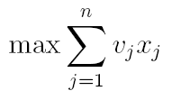
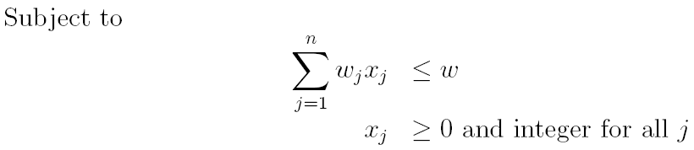
Knapsack Problem
Decision Variables:
Objective Function:
Constraints:

Slide 2
Knapsack Problem
Applications
Loading consignments in a truck or railway wagon.
Packing telecom bandwidth requirement in high-capacity facilities.
Heuristic Approach
For each item, compute the ratio of v_{i}/w_{i} (Bang for the Buck ratio)
Value per unit of Knapsack space
Which item provides the maximum value per unit of resource ?
Highest v_{i}/w_{i} ratio.

Slide 3
Knapsack Problem
A Greedy Heuristic:
Compute Bang for the Buck ratio for each item.
Sort items in decreasing ratio.
Pack items, one by one, from the sorted list, dropping those that cannot be packed.

Slide 4
Knapsack Problem: Example
Consignment weight Value of Value/box
Number (w_{i}) Cons. (v_{i}) (v_{i}/w_{i})
--------------- ---------------- ---------------- -----------
1 30 60 2.0
2 50 60 1.2
3 40 40 1.0
4 10 10 1.0
5 40 20 0.5
6 30 10 0.33
7 10 3 0.3
--------------------------------------------------------------------------------
100
90
80
70
60
50
40
30
20
10
0
Solution:
x1 = x2 = x4 = x7 = 1
x3 = x5 = x6 = 0.
Z = 60+60+10+3 = 133

Slide 5
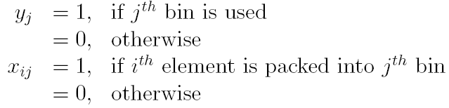
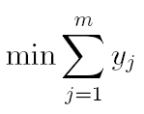
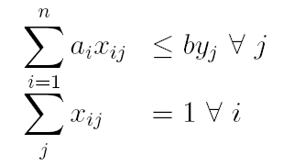
Bin Packing Problem
Decision Variables:
Objective Function:
Constraints:

Slide 6
Bin Packing Heuristic
Bin Packing Heuristic:
Step 0: Sort objects in decreasing order of size.
Step 1: Open a new bin.
Step 2: Pack the first unpacked object that will fit in it. Pack as many objects as possible.
Step 3: If all objects packed, Stop, else go to Step 1.

Slide 7
76 68 52 47 47 40 40 40 35 35 35 35 30
30 30 25 25 25 25 25 25 16 16 14 14 14
16
14
16
25
30
30
30
14
47
25
14
40
40
35
35
25
25
76
68
52
47
40
35
35
25
25

Slide 8
Travelling Salesman Problem
Given a set of cities and distances among them, find a minimum distance tour that visits each city exactly once.
Applications
Routing of trucks
Order Picking in a warehouse
Circuit board drilling

Slide 9

Model of TSP
(Where S’ is the compliment of S
and N is the set of all cities)

Slide 10
Branch and Bound Algorithm for TSP
Relaxing subtour breaking constraints, yields an assignment problem.
Easy to solve using Hungarian Algorithm.
Provides a lower bound.
Solution is integral but subtour breaking constraints may be violated.
How to fix that?
Using a Branch and Bound Algorithm.

Slide 11
Example: 5-node TSP
Total cost = 154
1-2-5-1, 3-4-3
Z = 154
× 31 90 48 24
31 × 66 26 35
90 59 × 32 67
48 26 32 × 25
24 35 67 25 ×
X₃₄ = 0
X₄₃ = 0
1-5-1, 2-4-3-2
Z = 165
1-5-1, 2-3-4-2
Z = 172
F
Total cost = 165
Total cost = 172
Total cost = 180
Total cost = 171
X₁₅ = 0
X₅₁ = 0
× 31 90 48 24
31 × 66 26 35
90 59 × × 67
48 26 32 × 25
24 35 67 25 ×
× 31 90 48 24
31 × 66 26 35
90 59 × 32 67
48 26 × × 25
24 35 67 25 ×
× 31 90 48 ×
31 × 66 26 35
90 59 × × 67
48 26 32 × 25
24 35 67 25 ×
× 31 90 48 24
31 × 66 26 35
90 59 × × 67
48 26 32 × 25
× 35 67 25 ×
1-2-4-3-5-1
Z = 180
1-5-4-3-2-1
Z = 171
F
F

